Slide 1
The Place of Storytelling in Jewish Ministry:
Rediscovering the Lost Treasures of Hebraic Narrative Epistemology
Bill Bjoraker, PhD.
William Carey Int. Univ.
Operation Ezekiel, Inc.

Slide 2
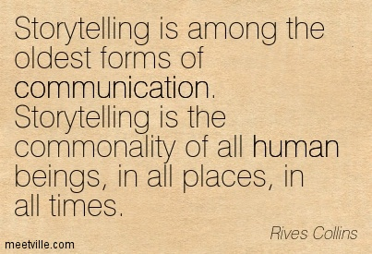
History = HisStory
Notes:
Between 60% and 70% of the canonical Scriptures are in the narrative genre. Yeshua the Messiah used stories as his primary teaching method. He used stories to teach both the am ha aretz (the common folk) in Galilee and also for the most highly literate and erudite Torah scholars of his day in Jerusalem. He is the Master Teacher and our exemplar for our teaching vocations.

Slide 3
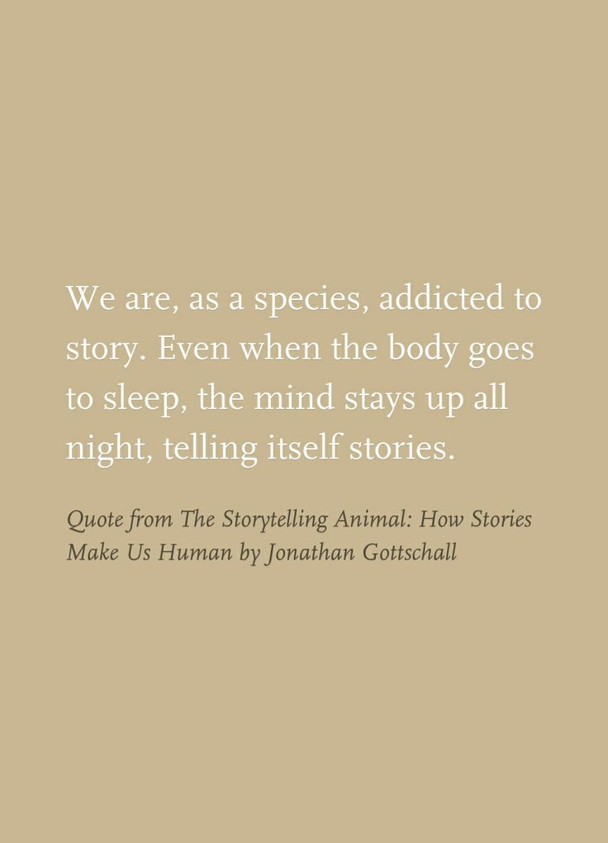
We are “Homo Narrans”
The Storytelling Animal

Slide 4
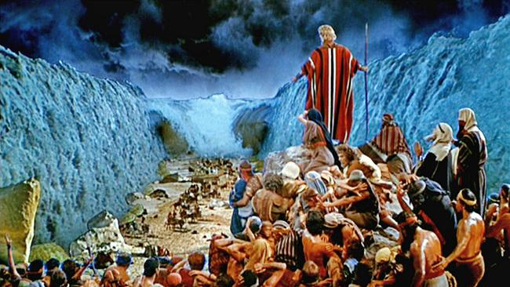
Narrative 1: Hebraic Theology Is Based on Story
Notes:
Psalm 78 –Retelling the Story and stories (what is done in feasts of Israel) –
O my people, listen to my instructions.
Open your ears to what I am saying,
for I will speak to you in a parable (Hebrew: “mashal,” a wisdom saying, poem, or story)
I will teach you hidden lessons from our past—
stories we have heard and known,
stories our ancestors handed down to us.
We will not hide these truths from our children;
we will tell the next generation
about the glorious deeds of the LORD,
about his power and his mighty wonders” (Verses 1-4 New Living Translation, NLT).

Slide 5
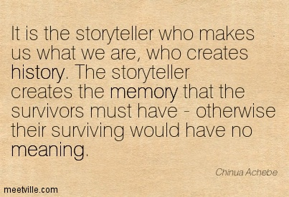
Jewish Survival = Jewish Saga

Slide 6
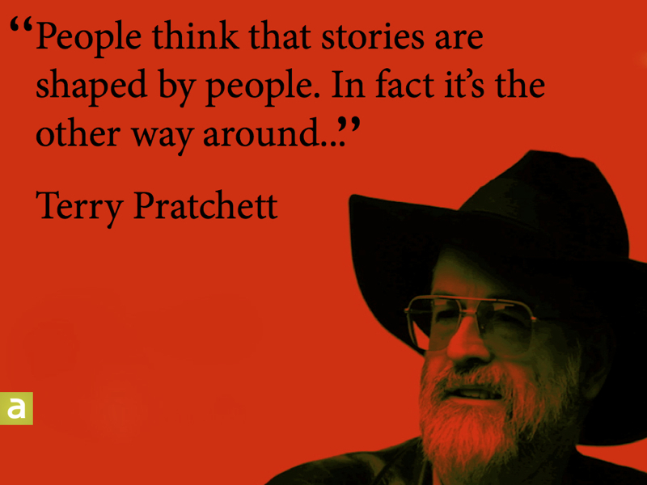
Story(ies) Shape Communities & Individuals

Slide 7
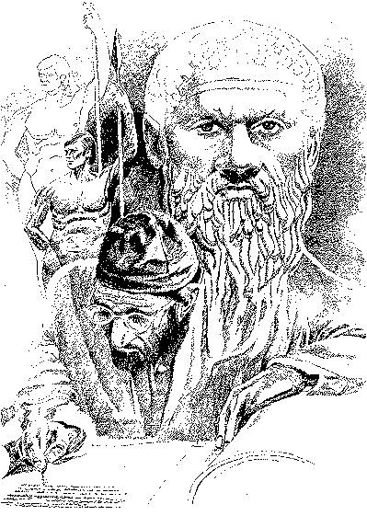
Narrative 2: The Hebraic & Jewish Roots of Story & Storytelling
Hebrew and Greek Man
Notes:
Greeks told stories, too.. ALL THE GREEK MYTHOLOGY! But they also developed the classical, rational, abstract, logical left-brained, philosophical mind (Socrates, Plato, Aristotle)..before the Hebrews… Later Hebrews, Talmudic times, bought into it.

Slide 8

Narrative 3: Hear O Israel! Orality Is Fundamental to Human Communication
Notes:
The Word of God is in three forms:
1) The Living Word (the “Memra” in Aramaic [similar to Hebrew], comparable to the “Logos” in Greek), who became flesh (John 1:1-14)
2) The Written Word (in This Age, the final authority for faith and life)
3) The Oralized Word (Scripture brought to life through human communicators…the Word Made Flesh…the Word Made Fresh).

Slide 9
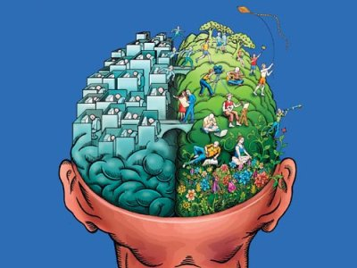
Narrative 4: European Enlightenment Epistemology
Notes:
-The moral sources, in this case epistemological, become disengaged reason … [Definition: The concept of reason or rationality disengaged from external, objective and transcendent verities and/or moral absolutes that had served as guideposts (touchstones, anchors, tethers) for the practice of rationality and the ascertaining knowledge]… and the deliverances of such reason via the highly acclaimed modern scientific method.
Disengaged reason became supreme in Enlightenment William D. Bjoraker, “Faith, Freedom and Radical Individualism in Late Modern A“Faith merica: A Missiological Evaluation” (PhD diss., Fuller Theological Seminary, 2007), 365-66.
- Daniel Pink has argued that our postmodern moment in Western history is a time of “right brain rising.” To put very simply the argument of his book: “Left brain direction” (rational, scientific, analytic, text-oriented, logical, linear, sequential, detail-oriented) was dominant during modernity. “Right brain direction” (artistic, aesthetic, emotional and relational expression, literary, synthesis, non-linear, context-oriented, big-picture, holistic, image, metaphor, and story-orientation) is rising in postmodernity out of human hunger for its lack during modernity. Right brain aptitudes are increasingly desired and needed. Left brain direction remains necessary, but it is no longer sufficient. We need a “whole new mind,” a holistic mind.
Daniel H. Pink, A Whole New Mind: Why Right-Brainers Will Rule the Future (New York: Riverhead Books, 2005).

Slide 10
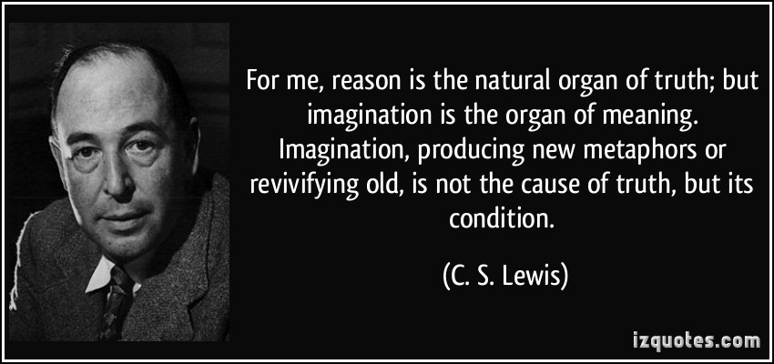
Narrative 5: Hebraic Epistemology
Notes:
“Language is the house of being,” said philosopher Martin Heidegger. We learn about how the Israelites knew what they knew, and how they knew the world through their Hebrew language.
Hebrew is Concrete. “Hebrew may be called primarily a language of the senses. The words originally expressed concrete or material things and movements or actions which struck the senses or started the emotions. Only secondarily and in metaphor could they be used to denote abstract or metaphysical ideas.” (Marvin Wilson)
2. Hebrew is Relational in Terms and Perceptions. German Jewish philosopher Martin Buber (1878–1965) in his classic work, I and Thou, explains that “I-Thou” encounters with persons are fundamentally different than “I-It” relationships with things. Storytelling is inherently relational. A story is told by someone to someone. The hearers of the story vicariously encounter the characters in the story, identify with them, and have emotional and moral responses to them (positively or negatively), sometimes in life-changing ways.
3. Hebrew Reflects Experiential Knowledge. When thinking about God, Israelites don’t ask, “What is divinity?” (the philosophical essence of divine being). Rather they ask, “Who is God?” … “Who is Yahweh? The Hebrew word, “yada,” refers to an experiential knowing, more than to mere cerebral cognition. Genesis says, “Adam knew (yada) his wife Eve, and she conceived” (Gen. 4:1). “This is eternal life that you might know (experientially) God and Yeshua the Messiah whom He has sent” (John 17:3). Stories relay real life experiences, encounters, first hand experiences, and often the accounts of eyewitnesses.
Walter Brueggemann calls story “Israel’s primal mode of knowing,” for it is the foundation from which come all other knowledge claims we have. … “the story can be told as a base line. The story of Israel and the land could not be reduced to a thesis. Only the narrative tension of the stories could hold together the complexity of the revelation of God’s relationship with Israel.”

Slide 11
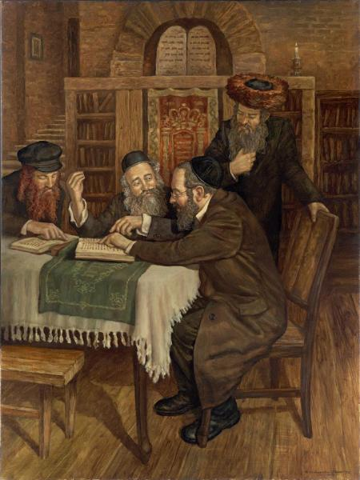
Narrative 6: Jewish Midrash & Story
Notes:
Jewish writers and producers Darren Aronofsky and Ari Handel put an example of a midrash on the Noah story to the big screen in 2014. Simply called “Noah,” and starring Russell Crowe in the lead role, the movie is a visual midrash. The Noah story is an epic, archetypal story and begs for midrash. In the movie, after Noah has heard from God, his wife asks him, “Noah, what did he say?” Noah says, “He is going to destroy the world.” What kind of man was this, entrusted by the Creator with overseeing such a daunting, overwhelming venture? The human drama of this for Noah and his family, their relatives and neighbors would have included times of high anxiety, tension, and emotion. These were real flesh and blood people, like you and me. That Noah got drunk and naked in his tent after it was all over is surely human realism. After years of high stress, Noah unwound, released his inhibitions, his inner moral restraints had collapsed. Compare this with the Sunday School sanitized versions of saintly old Noah with his long white beard, with all the gentle animals, represented by this children’s song,
“The Lord told Noah to build him an arky, arky,
The Lord told Noah to build him an arky, arky,
Build it out of gopher barky, barky, children of the Lord.”
These are surely crafted and edited versions of the story, more distant from the way it most likely really was than is Aronofsky’s and Handel’s visual midrash. Brad Jersak commented on the “evangelical panic” caused by the movie in his blog after “Noah” was released,
I don’t think anyone should be surprised at the usual course of Evangelical reactions decrying the movie for its “biblical inaccuracies.” … Of course, citing inaccuracies implies that the measure of faithfulness to Scripture is somehow photocopying Genesis 6–9 into the screenplay in a sort of word for word depiction. It’s this paint-by-numbers mentality that keeps many an Evangelical trapped within the lines of their own assumptions—as if taking the text literally was remotely akin to taking it seriously. Not so!
Those who love Scripture and want to see its stories reach the broadest possible audience have cause to applaud this visual midrash, the “Noah” movie. The Christian Post reported in the days following the release of the movie, “Two of the most popular online destinations for Bible readers reported robust increases in traffic in the first book of the Old Testament following the release of ‘Noah’ last week.” YouVersion reported that “in the days after Noah hit theaters, people opening the Noah story in Genesis 6 increased about 300% in US & 245% globally on @YouVersion.” Bible Gateway reported that “visits to the Noah story in Genesis 6–9 at Bible Gateway saw a 223% increase over the previous weekend.”
Brad Jersak, “Noah: Who Are the Watchers and Why the Panic?,” Clarion: Journal of Spirituality and Justice, March 31, 2014, accessed December 14, 2014, http://www.clarion-journal.com/clarion_journal_of_spirit/2014/03/noah-who-are-the-watchers-and-why-the-panic-by-brad-jersak.html.
http://www.christianpost.com/news/noah-movie-sparks-massive-spike-in-global-reading-of-bible-book-of-genesis-117334/.
https://twitter.com/YouVersion/status/451415236675764224.
https://www.biblegateway.com/blog/2014/04/noah-generates-a-flood-of-bible-readers-over-the-weekend/.

Slide 12

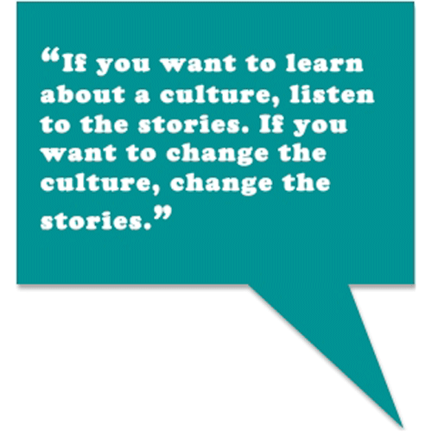
Narrative 7: Story Has Power

Slide 13
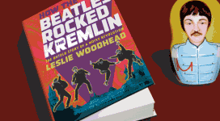
“Let Me Write the Songs of a Nation &
I Care Not Who Writes Their Laws”

Slide 14
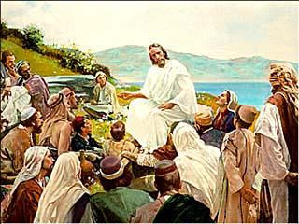
Narrative 8: Yeshua the Messiah: Master Teacher and Storyteller

Slide 15
Narrative 9: The Postmodern Moment and Its Prospects for Story
Orality Era | Textuality Era | Digitorality Era
Invention of the alphabet & writing (circa. 2000 BC) | Invention of movable type printing (Gutenberg, 1437), | Invention of personal computers and the Internet (1980s)
Pre-literate | Print literacy | Digital literacy
Ancient | Modern | Post- or Late Modern
Events, Stories | Words, Ideas | Images, Stories, Ideas
Oral communication by all, Storytellers, oral tradition. | Books, newspapers, libraries, printed matter. | Television, personal computers, plethora of electronic i-devices, etc.
Right Brain Dominant | Left Brain Dominant | Left & Right Brain Needed
Oral Galaxy | Gutenberg Galaxy | Digitoral Galaxy
Notes:
When media changes, people are changed by those media. A question many observers are asking is—will our dependence on this new media rewire our brains? Younger generations today, though they are literate, have been conditioned by the digital revolution to prefer to get their information not from reading print, but from other electronic media. This mentality is termed “secondary orality” by orality and literacy theorist Walter Ong, a term he coined for the new electronically mediated culture of spoken, as contrasted with written, language. The new media advances secondary orality, and secondary orality in turn is decreasing print literacy. This is not an entirely happy development. Ong, Orality, 11.

Slide 16
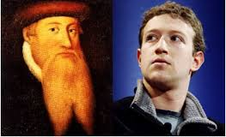
From Gutenberg to Zuckerberg
Notes:
Johannes…and Mark

Slide 17
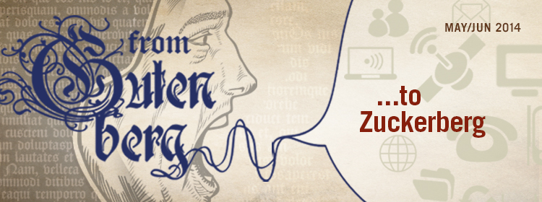
From Gutenberg to Zuckerberg: The “Digitoral Age”

Slide 18
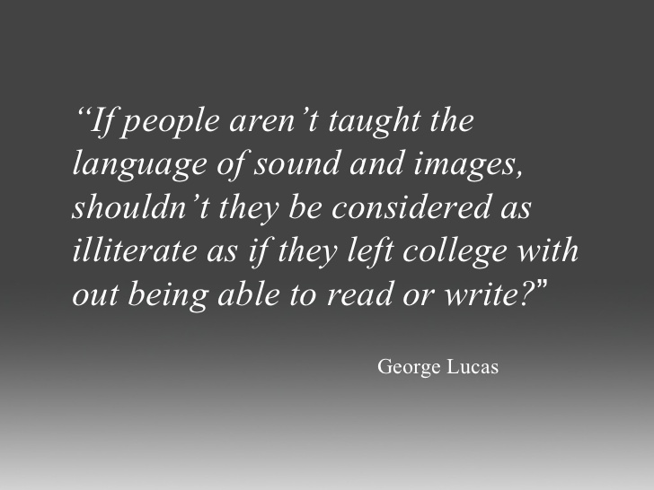
The Digitoral &
“Right- Brain Rising” Era

Slide 19
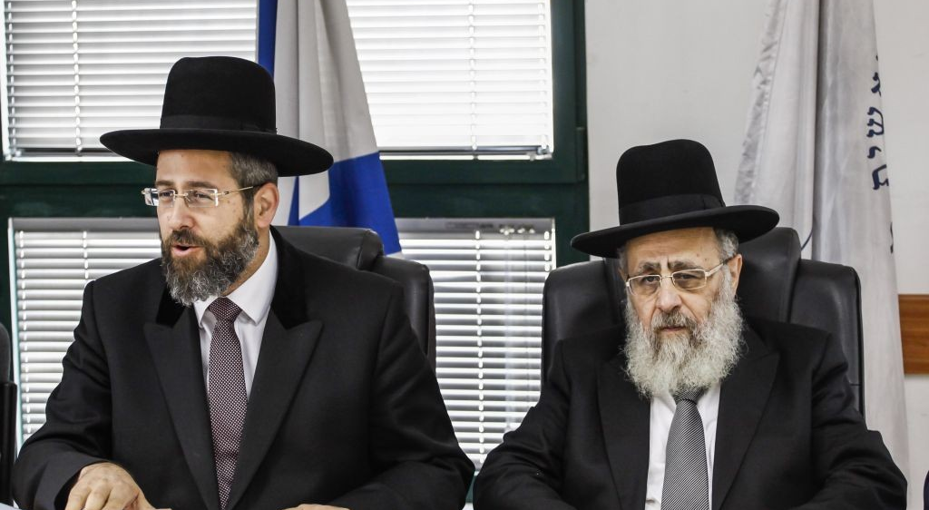
How Reach These People?
Notes:
Not Naked Truth, Head-On Apologetics…, thrusting and parrying fencing….But by end-run, subversive storytelling.
Last Summer at Hotel Gilgal, Tel Aviv.

Slide 20
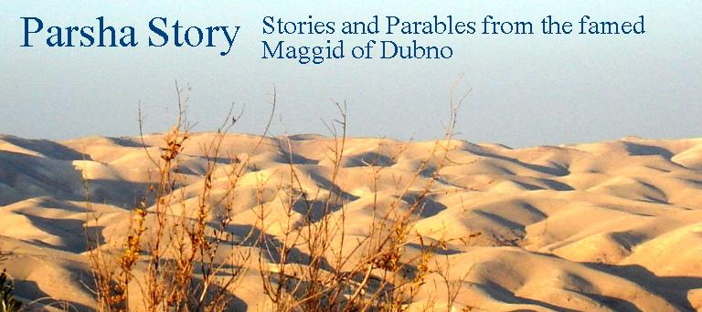
Narrative 10: Effective Use of Storytelling in Contemporary Jewish Ministry
Notes:
Rabbi Jacob ben Wolf Kranz of Dubno, known as the “Dubner Maggid,” was a Lithuanian-born preacher who lived from 1740 to 1804. “Maggid” is Hebrew for storyteller (from the same Hebrew root as “Aggadah” and “Haggadah”). A contemporary of the Vilna Gaon, the “Maggid” was famous for explaining Torah concepts by using a mashal or parable. Moses Mendelssohn named Kranz, “the Jewish Aesop.” The Dubner Maggid was once asked, “Why do you always tell stories? Why are stories so powerful?” Kranz’s legendary reply was to answer by telling the following story. It is a story about the power of stories Eliezer Steinbarg, ed., The Jewish Book of Fables (Dora Teitelboim Center for Yiddish Culture, 2003), xii.
*THE NATHAN PRINCIPLE -(2 Sam. 12:1-14 ESV). The Dubner Maggid’s “Truth & Story” (or “Truth & Parable”).

